Slide 1
Behavioral Design Pattern
Instructor: Mehroze Khan

Slide 2
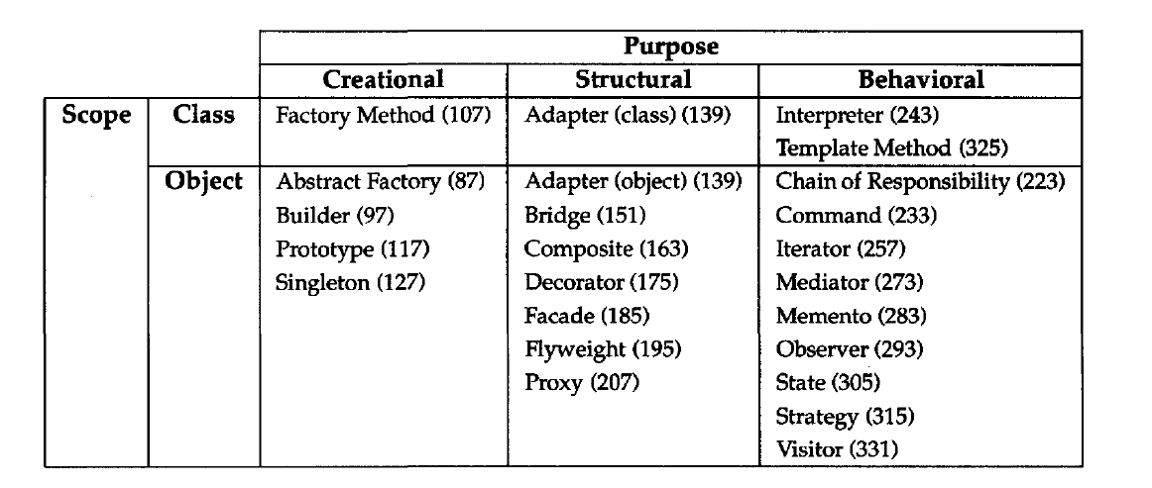
Behavioral Design Pattern
Behavioral design patterns are concerned with algorithms and the assignment of responsibilities between objects.
Behavioral patterns describe not just patterns of objects or classes but also the patterns of communication between them.

Slide 3
Iterator Pattern

Slide 4
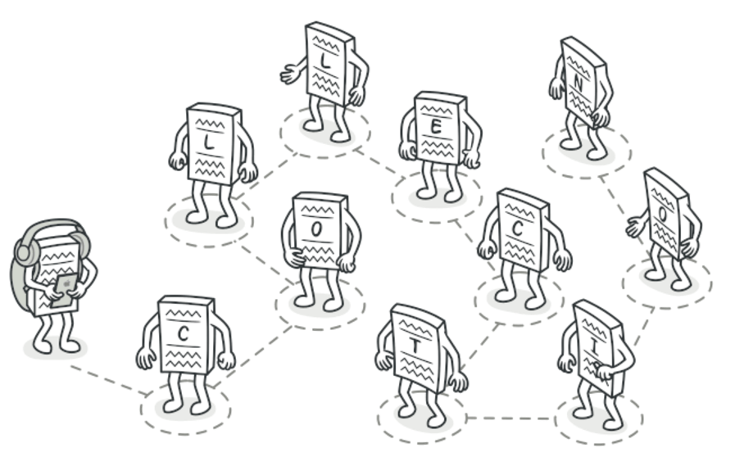
Iterator Pattern
Intent:
Iterator is a behavioral design pattern that lets you traverse elements of a collection without exposing its underlying representation (list, stack, tree, etc.).

Slide 5
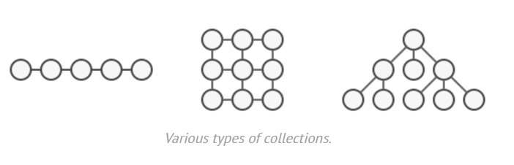
Problem
Most collections store their elements in simple lists. However, some of them are based on stacks, trees, graphs and other complex data structures.
But no matter how a collection is structured, there should be a way to go through each element of the collection without accessing the same elements over and over.
This may sound like an easy job if you have a collection based on a list. You just loop over all of the elements.
But how do you sequentially traverse elements of a complex data structure, such as a tree? For example, one day you might be just fine with depth-first traversal of a tree. Yet the next day you might require breadth-first traversal. And the next week, you might need something else, like random access to the tree elements.

Slide 6
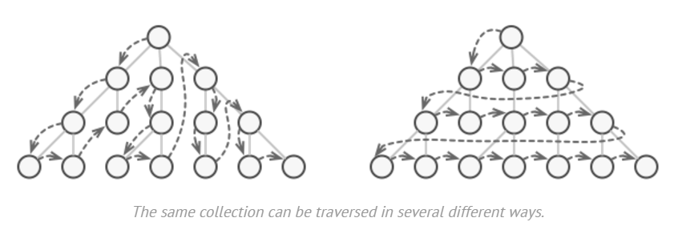
Problem
Adding more and more traversal algorithms to the collection gradually blurs its primary responsibility, which is efficient data storage.
Client code that’s supposed to work with various collections may not even care how they store their elements. However, since collections all provide different ways of accessing their elements, you have no option other than to couple your code to the specific collection classes.

Slide 7
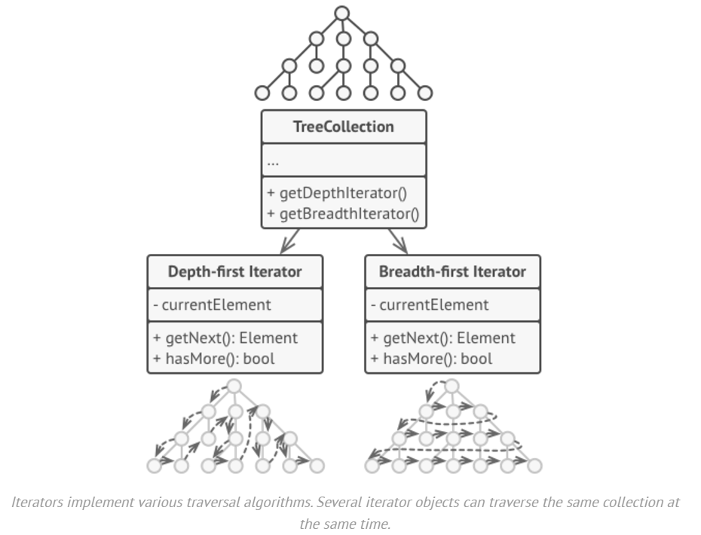
Solution
The main idea of the Iterator pattern is to extract the traversal behavior of a collection into a separate object called an iterator.

Slide 8
Solution
An iterator object encapsulates all of the traversal details, such as the current position and how many elements are left till the end.
Several iterators can go through the same collection at the same time, independently of each other.
Iterators provide one primary method for fetching elements of the collection. The client can keep running this method until it doesn’t return anything, which means that the iterator has traversed all of the elements.
All iterators must implement the same interface. This makes the client code compatible with any collection type or any traversal algorithm.
If you need a special way to traverse a collection, you just create a new iterator class, without having to change the collection or the client.

Slide 9
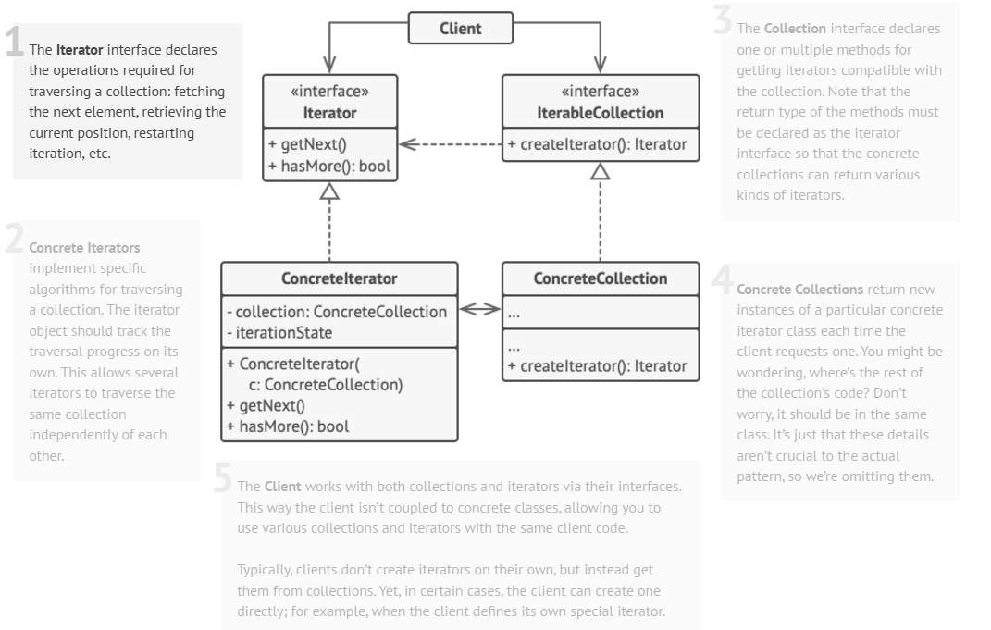
Structure

Slide 10
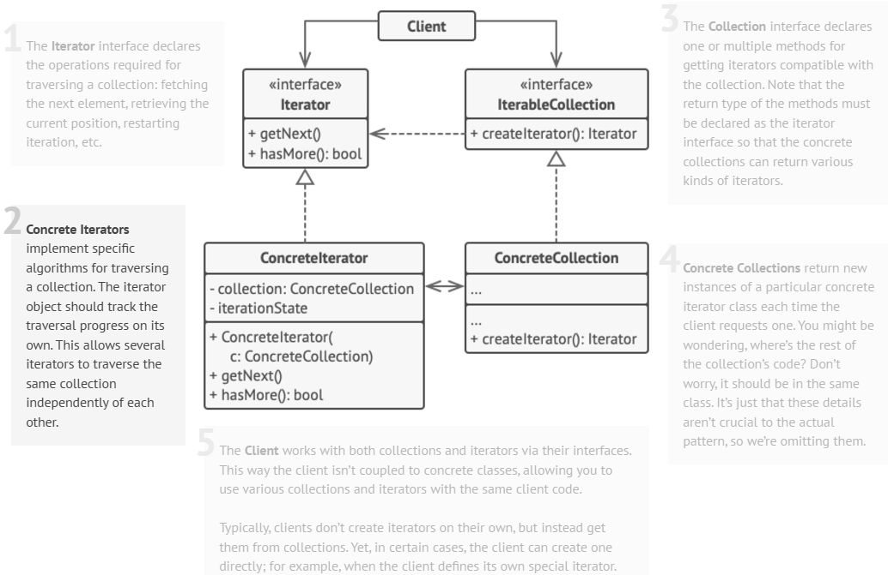
Structure

Slide 11
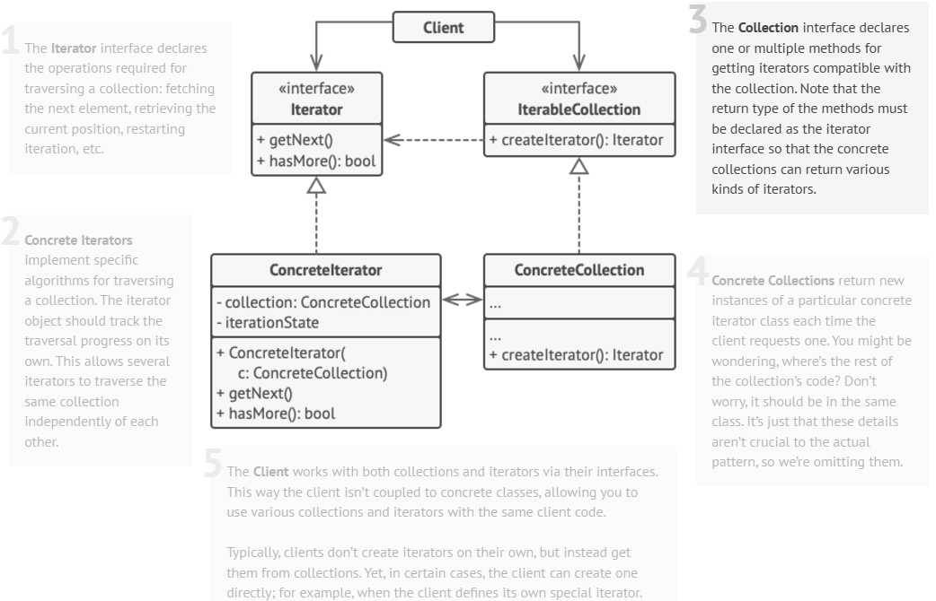
Structure

Slide 12
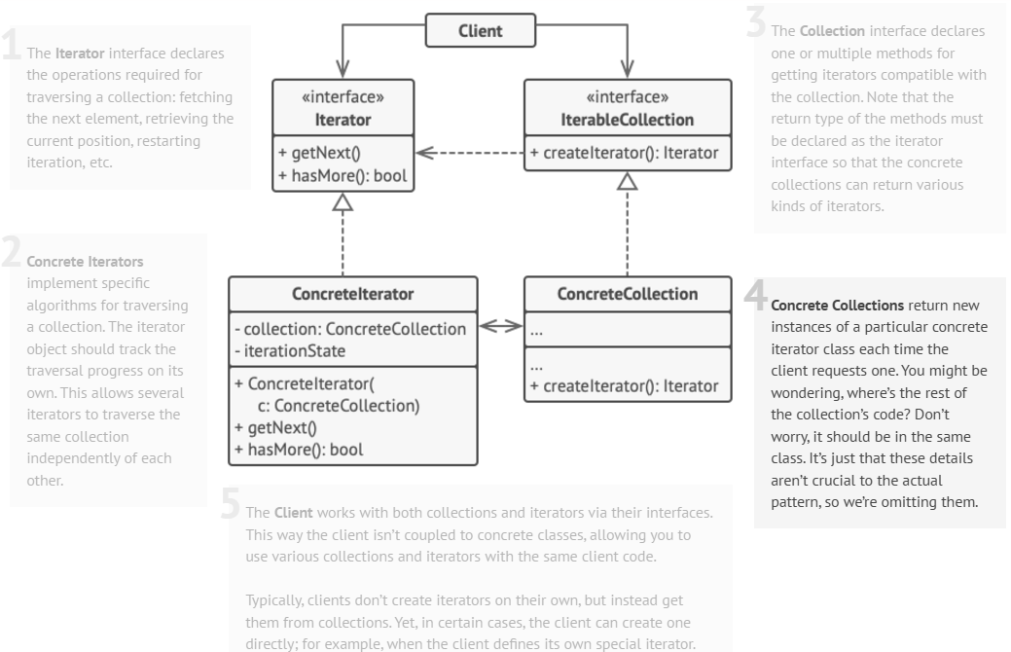
Structure

Slide 13
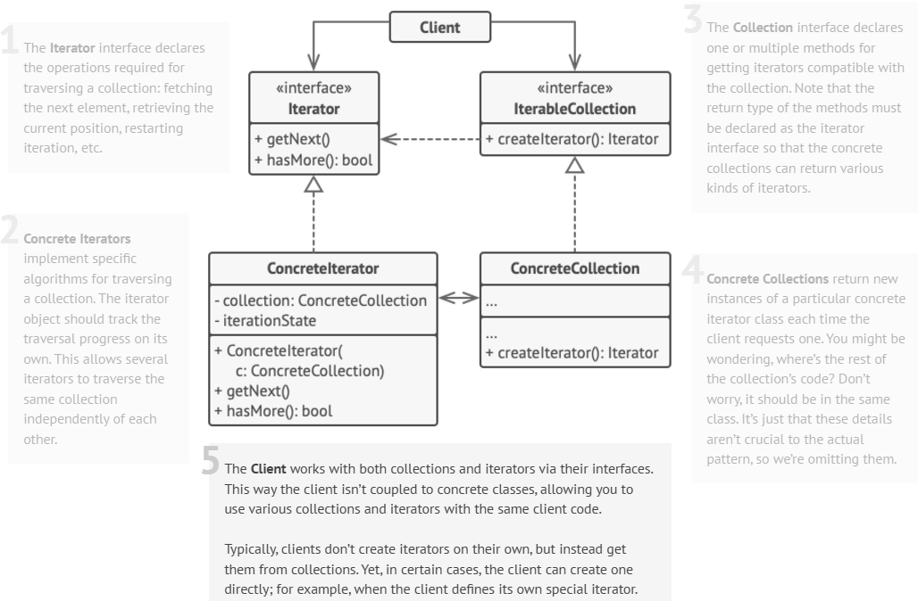
Structure

Slide 14
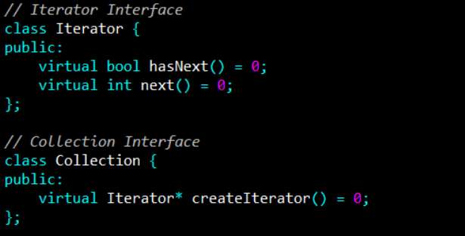
Example

Slide 15
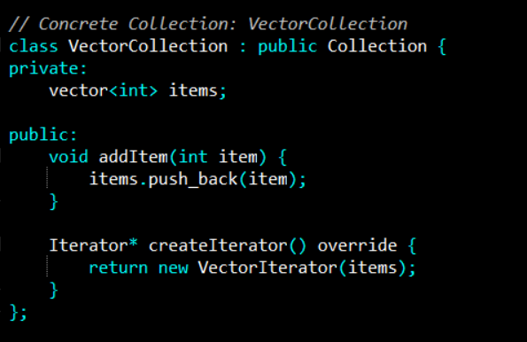
Example

Slide 16
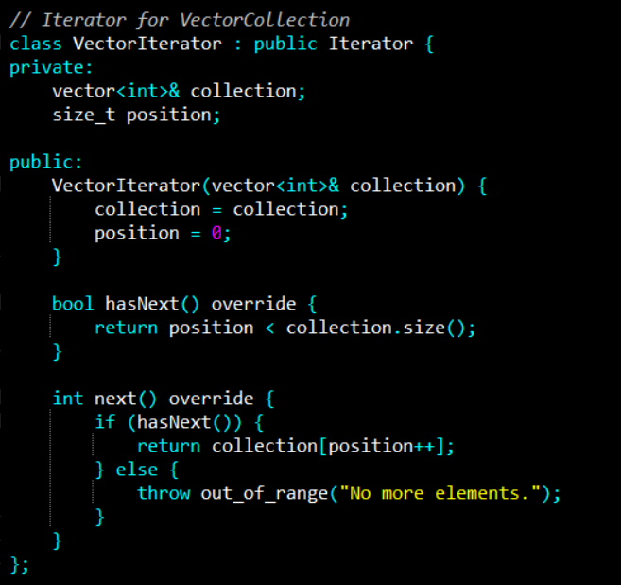
Example

Slide 17
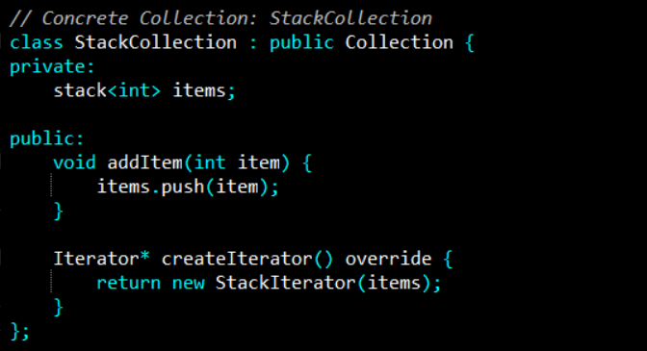
Example

Slide 18
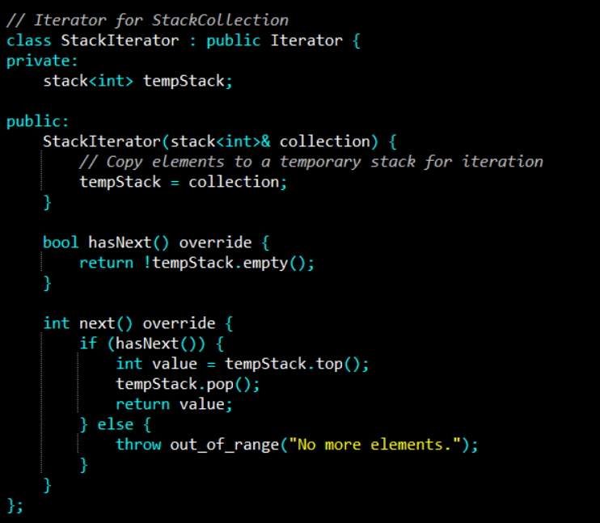
Example

Slide 19
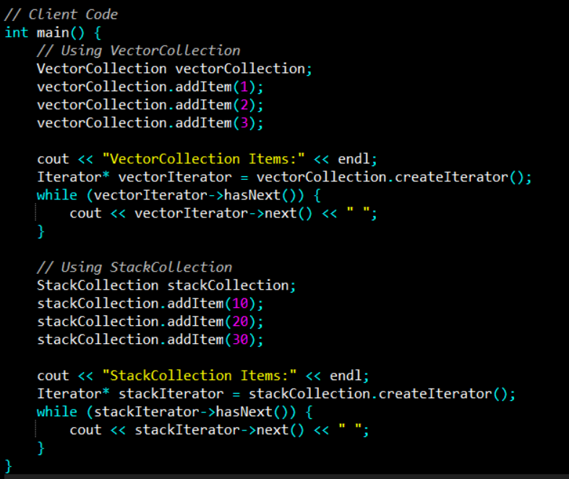
Example
Notes:
VectorCollection Items:
1 2 3
StackCollection Items:
30 20 10

Slide 20
References
Design Patterns: Elements of Reusable Object-Oriented Software, Erich Gamma, Richard Helm, Ralph Johnson, and John Vlissides, Pearson, 1995.
Helping Links:
https://refactoring.guru/design-patterns/

